Slide 1
Amrutvahini College of Engineering, Sangamner
Department of Computer Engineering
UNIT-5
Memory Management
By: Ms. Panhalkar A. R.

Slide 2
Syllabus
Introduction: Memory Management concepts, Memory Management requirements.
Memory Partitioning: Fixed Partitioning, Dynamic Partitioning, Buddy Systems Fragmentation, Paging, Segmentation, Address translation.
Placement Strategies: First Fit, Best Fit, Next Fit and Worst Fit.
Virtual Memory (VM): Concepts, Swapping, VM with Paging, Page Table Structure, Inverted Page Table, Translation Look aside Buffer, Page Size, VM with Segmentation, VM with Combined paging and segmentation.
Page Replacement Policies: First In First Out (FIFO), Last Recently Used(LRU), Optimal,Thrashing.
Reference Book: Silberschatz, Galvin, Gagne, "Operating System Principles", 9th Edition, Wiley, ISBN 978-1-118-06333-0

Slide 3
Course Objective
To study Intel 80386 architecture and differentiate memory management techniques.
Course Outcome
Interpret Intel 80386 and analyze concepts of memory management in OS.

Slide 4
Background
Memory Management
Program must be brought (from disk) into memory and placed within a process for it to be run
Main memory and registers are only storage CPU can access directly
Memory unit only sees a stream of addresses + read requests, or address + data and write requests
Register access in one CPU clock (or less)
Main memory can take many cycles, causing a stall
Cache sits between main memory and CPU registers
Protection of memory required to ensure correct operation

Slide 5
Memory Management
Ideally programmers want memory that is
large
fast
non volatile
Memory hierarchy
small amount of fast, expensive memory – cache
some medium-speed, medium price main memory
gigabytes of slow, cheap disk storage
Memory manager handles the memory hierarchy

Slide 6
Memory Management
Is the task carried out by the OS and hardware to accommodate multiple processes in main memory
If only a few processes can be kept in main memory, then much of the time all processes will be waiting for I/O and the CPU will be idle
Hence, memory needs to be allocated efficiently in order to pack as many processes into memory as possible

Slide 7
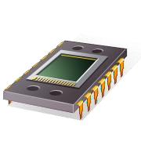
Memory Requirements
In most schemes, the kernel occupies some fixed portion of main memory and the rest is shared by multiple processes
Memory management is intended to satisfy the following requirements:
Relocation
Protection
Sharing
Logical organization
Physical organization

Slide 8
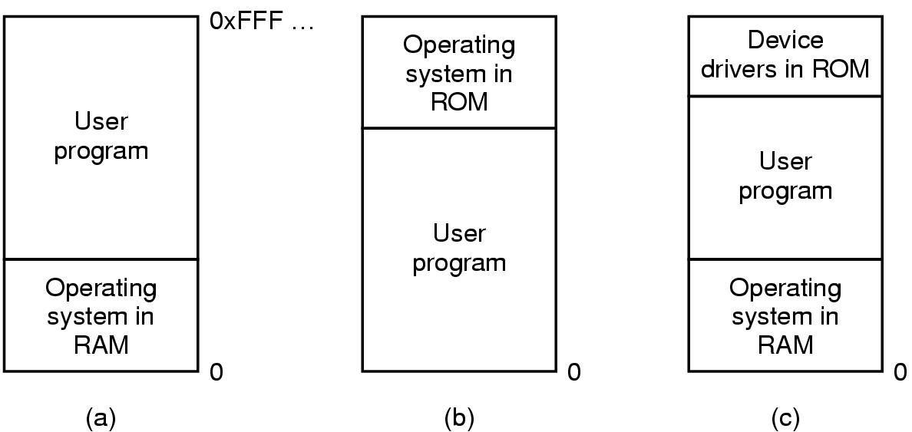
Basic Memory Management Techniques
1. Uni-programming without Swapping or Paging
Three simple ways of organizing memory
- an operating system with one user process

Slide 9
2. Multiprogramming with Fixed Partitions
Operating System 8M
Operating System 8M
2M
8M
4M
6M
8M
8M
8M
8M
8M
8M
12M
8M
16M
8M
(a) Equal-size partitions
(b) Unequal-size partitions
Example of Fixed Partitioning of a 64-Mbyte Memory

Slide 10
2. Multiprogramming with Fixed Partitions
Equal-size partitions
If there is an available partition, a process can be loaded into that partition because all partitions are of equal size, it does not matter which partition is used
Operating System 8M
8M
8M
Disadvantages:
A program may be too big to fit in a partition
program needs to be designed with the use of overlays
Main memory utilization is inefficient
any program, regardless of size, occupies an entire partition
internal fragmentation
wasted space due to the block of data loaded being smaller than the partition
8M
8M
8M
8M
8M
(a) Equal-size partitions

Slide 11
2. Multiprogramming with Fixed Partitions
Unequal-size partitions: use of multiple queues
assign each process to the smallest partition within which it will fit
A queue for each partition size
tries to minimize internal fragmentation
Partition 4
900K
Partition 3
700K
Partition 2
600K
Partition 1
500K
100K
OS
0
Problem: some queues will be empty if no processes within a size range is present

Slide 12
2. Multiprogramming with Fixed Partitions
Unequal-size partitions: use of a single queue
When its time to load a process into main memory the smallest available partition that will hold the process is selected
increases the level of multiprogramming at the expense of internal fragmentation
Partition 4
900K
Partition 3
700K
Partition 2
600K
Partition 1
500K
100K
OS
0

Slide 13

2. Multiprogramming with Dynamic Partitions
Partitions are of variable length and number
Process is allocated exactly as much memory as it requires
This technique was used by IBM’s mainframe operating system, OS/MVT

Slide 14
Dynamic Partitioning: an example
A hole of 64K is left after loading 3 processes: not enough room for another process
Eventually each process is blocked. The OS swaps out process 2 to bring in process 4

Slide 15

Dynamic Partitioning
External Fragmentation
memory becomes more and more fragmented
memory utilization declines
Compaction
technique for overcoming external fragmentation
OS shifts processes so that they are contiguous
free memory is together in one block
time consuming and wastes CPU time

Slide 16
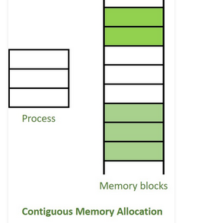
Contiguous and non-contiguous Memory Allocation
In the multiprogramming, the multiple users can share the memory simultaneously.
Contiguous memory allocation
Non-contiguous memory allocation
Contiguous memory allocation
single contiguous section/part of memory is allocated to a process or file needing it.
Because of this all the available memory space resides at the same place together,
the freely/unused available memory partitions are not distributed in a random fashion here and there across the whole memory space.

Slide 17
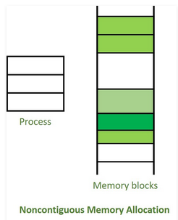
Non-Contiguous Memory Allocation :
the contrary to contiguous allocation method
allocates the memory space present in different locations to the process as per it’s requirements.
As all the available memory space is in a distributed pattern so the freely available memory space is also scattered here and there.
This technique of memory allocation helps to reduce the wastage of memory, which eventually gives rise to Internal and external fragmentation.

Slide 18
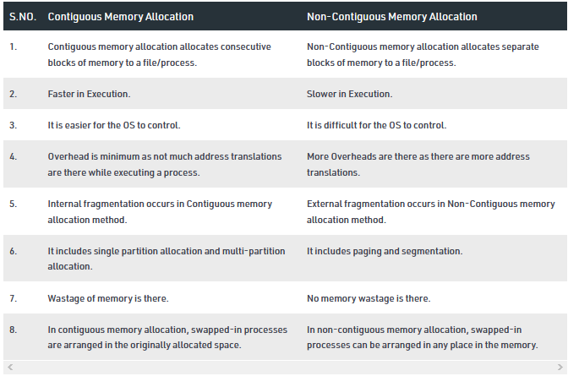
Contiguous and non-contiguous Memory Allocation

Slide 19

Relocation
The OS cannot be certain where a program will be loaded in memory
Variables and procedures can’t use absolute locations in memory
Active processes need to be able to be swapped in and out of main memory in order to maximize processor utilization
Specifying that a process must be placed in the same memory region when it is swapped back in would be limiting
may need to relocate the process to a different area of memory

Slide 20
Swapping
C
C
C
C
C
B
B
B
B
A
A
A
A
D
D
D
OS
OS
OS
OS
OS
OS
OS
Memory allocation changes as
Processes come into memory
Processes leave memory
Swapped to disk
Complete execution
Gray regions are unused memory

Slide 21

Limitations of swapping
Problems with swapping
Process must fit into physical memory (impossible to run larger processes)
Memory becomes fragmented
External fragmentation: lots of small free areas
Compaction needed to reassemble larger free areas
Processes are either in memory or on disk: half and half doesn’t do any good
Overlays solved the first problem
Bring in pieces of the process over time (typically data)
Still doesn’t solve the problem of fragmentation or partially resident processes

Slide 22
Base and limit registers
Special CPU registers: base & limit
Access to the registers limited to system mode
Registers contain
Base: start of the process’s memory partition
Limit: length of the process’s memory partition
Address generation
Physical address: location in actual memory
Logical address: location from the process’s point of view
Logical address larger than limit => error
0xFFFF
0x2000
Limit
Process partition
Base
0x9000
OS
0
Physical address = base + logical address
Logical address: 0x1204 Physical address: 0x1204+0x9000 = 0xa204

Slide 23
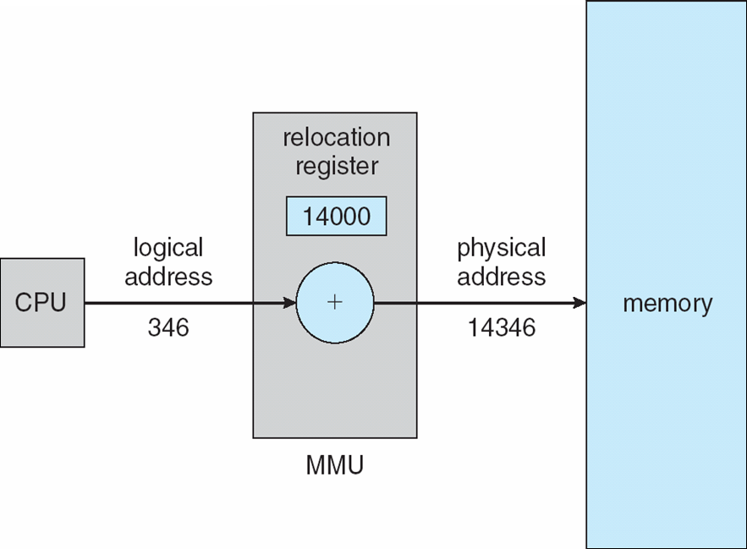
Memory-Management Unit (MMU)
Hardware device that maps virtual to physical address at run time
The value in the relocation register is added to every address generated by a user process at the time it is sent to memory
Base register now called relocation register
The user program deals with logical addresses; it never sees the real physical addresses
Execution-time binding occurs when reference is made to location in memory
Logical address bound to physical addresses

Slide 24
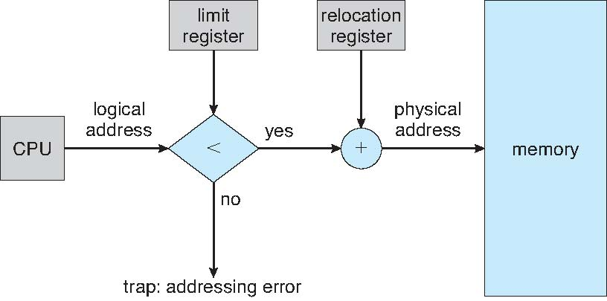
Hardware Support for Relocation and Limit Registers

Slide 25
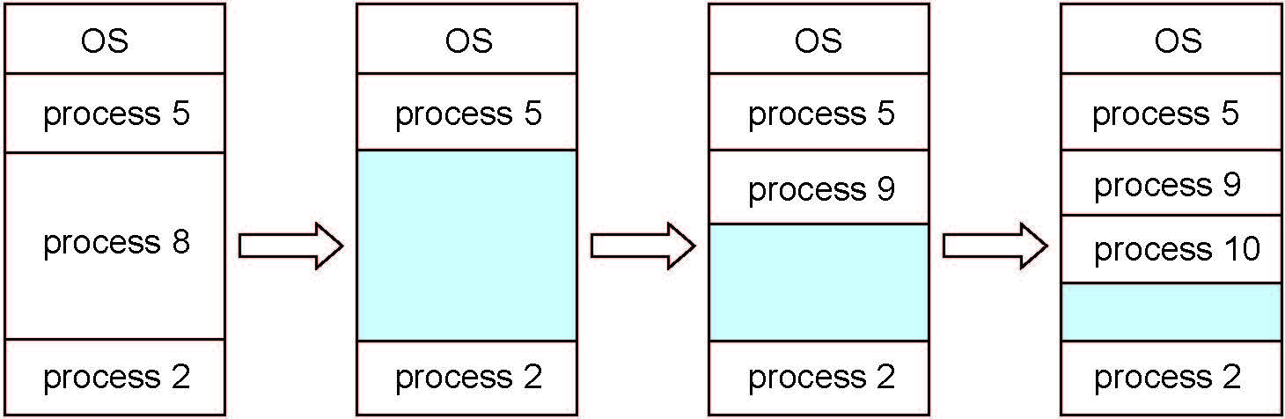
Multiple-partition allocation
Degree of multiprogramming limited by number of partitions
Variable-partition sizes for efficiency (sized to a given process’ needs)
Hole – block of available memory; holes of various size are scattered throughout memory
When a process arrives, it is allocated memory from a hole large enough to accommodate it
Process exiting frees its partition, adjacent free partitions combined
Operating system maintains information about: a) allocated partitions b) free partitions (hole)

Slide 26
Dynamic Memory -Allocation Algorithms
How to satisfy a request of size n from a list of free holes?
First-fit: Allocate the first hole that is big enough
Best-fit: Allocate the smallest hole that is big enough; must search entire list, unless ordered by size
Produces the smallest leftover hole
Worst-fit: Allocate the largest hole; must also search entire list
Produces the largest leftover hole
First-fit and best-fit better than worst-fit in terms of speed and storage utilization

Slide 27
Fragmentation
As processes are loaded and removed from memory, the free memory space is broken into little pieces.
It happens after sometimes that processes cannot be allocated to memory blocks considering their small size and memory blocks remains unused.
This problem is known as Fragmentation.

Slide 28
There are mainly two types of fragmentation in the operating system. These are as follows:
Internal Fragmentation
External Fragmentation
Internal Fragmentation
The problem of internal fragmentation may arise due to the fixed sizes of the memory blocks.
When a process is allocated to a memory block, and if the process is smaller than the amount of memory requested, a free space is created in the given memory block.
Due to this, the free space of the memory block is unused, which causes internal fragmentation.
It may be solved by assigning space to the process via dynamic partitioning.

Slide 29
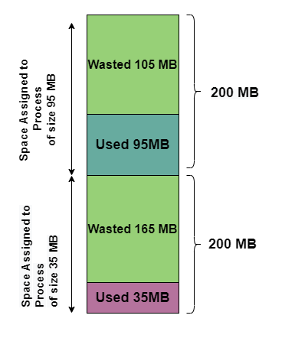
Internal Fragmentation

Slide 30
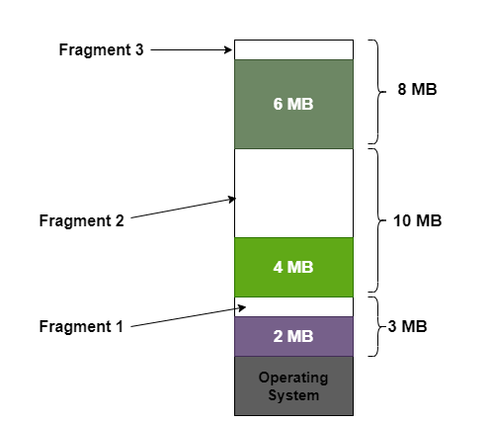
External Fragmentation
External fragmentation happens when a dynamic memory allocation method allocates some memory but leaves a small amount of memory unusable.
The quantity of available memory is substantially reduced if there is too much external fragmentation.
There is enough memory space to complete a request, but it is not contiguous.
It's known as external fragmentation.

Slide 31
Fragmentation
External Fragmentation – total memory space exists to satisfy a request, but it is not contiguous
Internal Fragmentation – allocated memory may be slightly larger than requested memory; this size difference is memory internal to a partition, but not being used
First fit analysis reveals that given N blocks allocated, 0.5 N blocks lost to fragmentation
1/3 may be unusable -> 50-percent rule

Slide 32
Fragmentation (Cont.)
Reduce external fragmentation by compaction
Shuffle memory contents to place all free memory together in one large block
Compaction is possible only if relocation is dynamic, and is done at execution time
I/O problem
Latch job in memory while it is involved in I/O
Do I/O only into OS buffers
Now consider that backing store has same fragmentation problems

Slide 33
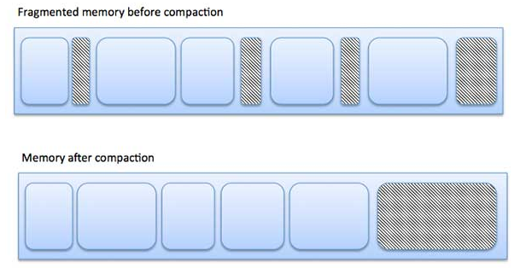

Slide 34
Segmentation
Memory-management scheme that supports user view of memory
A program is a collection of segments
A segment is a logical unit such as:
main program
procedure
function
method
object
local variables, global variables
common block
stack
symbol table
arrays

Slide 35
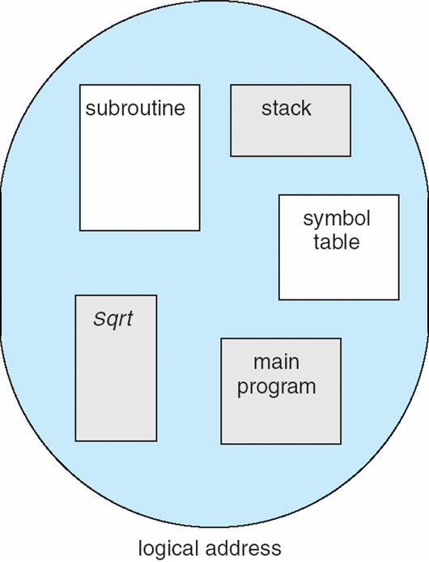
User’s View of a Program

Slide 36
Logical View of Segmentation
1
1
4
2
3
4
2
3
user space
physical memory space

Slide 37
Segmentation Architecture
Logical address consists of a two tuple:
<segment-number, offset>,
Segment table – maps two-dimensional physical addresses;
each table entry has:
base – contains the starting physical address where the segments reside in memory
limit – specifies the length of the segment
Segment-table base register (STBR) points to the segment table’s location in memory
Segment-table length register (STLR) indicates number of segments used by a program;
segment number s is legal if s < STLR

Slide 38
Segmentation Architecture (Cont.)
Protection
With each entry in segment table associate:
validation bit = 0 ⇒ illegal segment
read/write/execute privileges
Protection bits associated with segments; code sharing occurs at segment level
Since segments vary in length, memory allocation is a dynamic storage-allocation problem
A segmentation example is shown in the following diagram

Slide 39
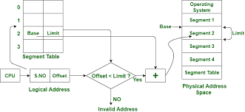

Slide 40
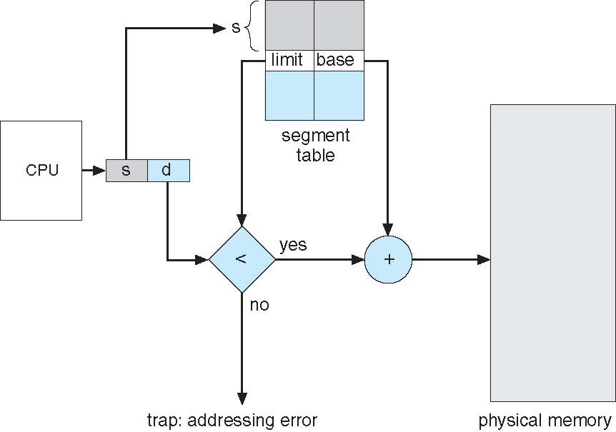
Segmentation Hardware

Slide 41

Virtual Memory
“Virtual Memory is a storage allocation scheme in which secondary memory can be addressed as though it were part of main memory”
Code needs to be in memory to execute, but entire program rarely used
Error code, unusual routines, large data structures
Entire program code not needed at same time
Ever wondered how a 10GB Game like God Of War fits into your 2GB RAM computer?

Slide 42
Virtual Memory
Consider ability to execute partially-loaded program
Program no longer constrained by limits of physical memory
Each program takes less memory while running -> more programs run at the same time
Increased CPU utilization and throughput with no increase in response time or turnaround time
Less I/O needed to load or swap programs into memory -> each user program runs faster

Slide 43
Virtual and physical addresses
Program uses virtual addresses
Addresses local to the process
Hardware translates virtual address to physical address
Translation done by the Memory Management Unit
Usually on the same chip as the CPU
Only physical addresses leave the CPU/MMU chip
Physical memory indexed by physical addresses
CPU chip
CPU
MMU
Virtual addresses from CPU to MMU
Memory
Physical addresses on bus, in memory
Disk controller

Slide 44

Paging
Goal
Eliminate external fragmentation
Don’t allocate memory that will not be used
Enable sharing
Idea: Divide memory into fixed-sized pages
Both virtual and physical memory are composed of pages
Logical Address Space (virtual memory)
physical memory
page 0
frame 0
page 1
frame 1
page 2
frame 2
page 3
MMU
…
…
frame Y
page X

Slide 45
Paging (cont…)
Processes see a contiguous virtual address space
Memory Manager divides the virtual address space into equal sized pieces called pages
Memory Manager divides the physical address space into equal sized pieces called frames
Frame size usually a power of 2 between 512 and 8192 bytes
Frame
Has same size as page
is a place where a (logical) page can be (physically) placed
sizeof(page) = sizeof(frame)

Slide 46

Implementing paging
Keep track of all free physical page frames
To run a program of size n pages, need to find n free frames and load program
Pages do not need to be contiguous!
Set up mapping from virtual to physical in page table
At memory reference time, translate virtual address to physical address using page table

Slide 47
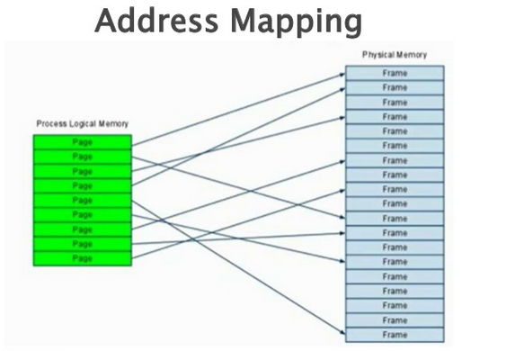
Paging (cont…)

Slide 48
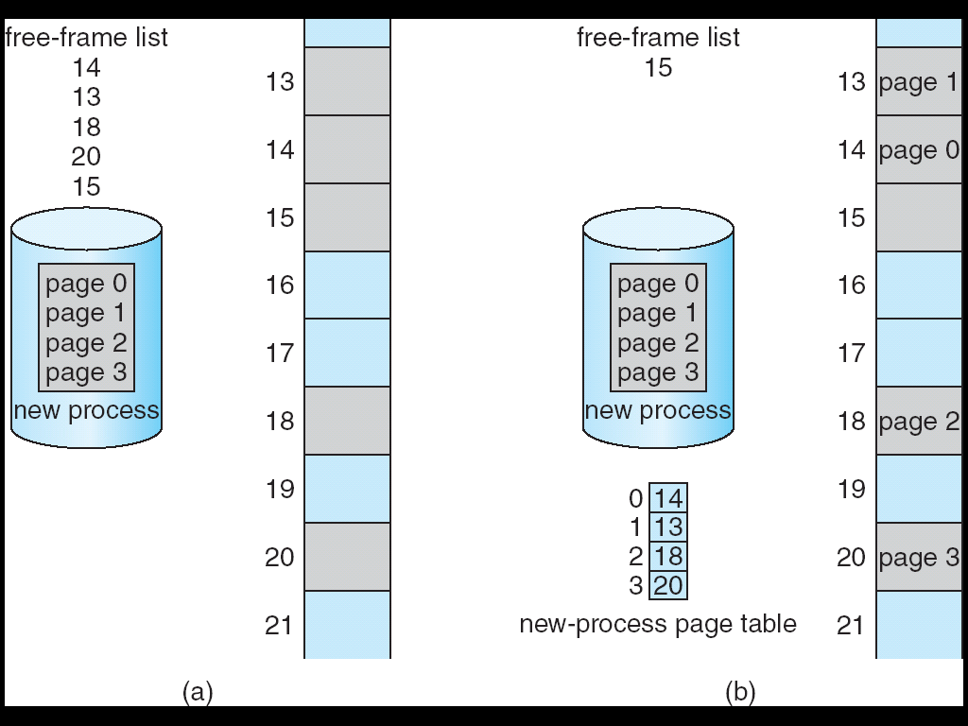
Free Frames
Paging (cont…)
Before allocation
After allocation

Slide 49
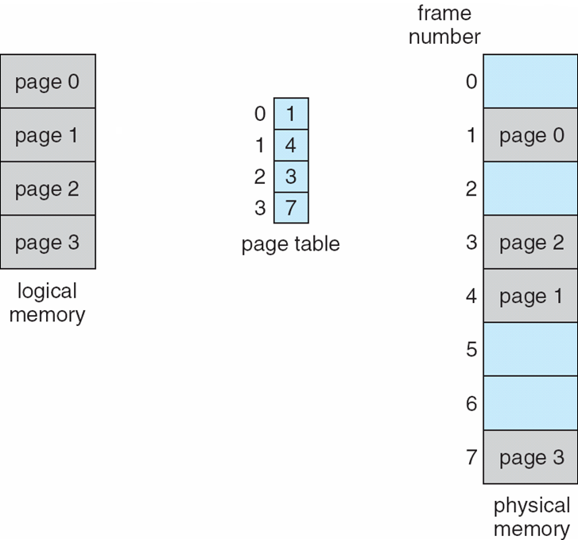
Paging Model of Logical and Physical Memory
Paging (cont…)
page table to translate logical to physical addresses

Slide 50
Memory & paging structures
Paging (cont…)
Physical memory
Page frame number
Page 0
6
Page 1
3
0
Page 1 (P1)
Page 2
4
1
Page 3
9
2
Page 4 (P0)
Page 4
2
3
Page 1 (P0)
Free
pages
4
Page 2 (P0)
Logical memory (P0)
Page table (P0)
5
6
Page 0 (P0)
Page 0
8
7
Page 1
0
8
Page 0 (P1)
9
Page 3 (P0)
Logical memory (P1)
Page table (P1)

Slide 51
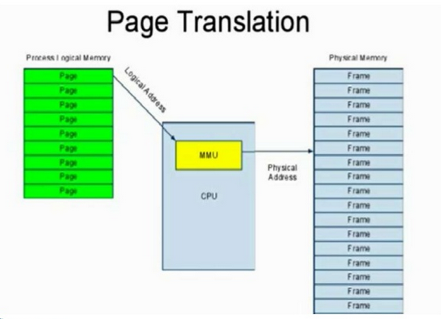
Paging (cont…)

Slide 52
Address Translation Scheme
Paging (cont…)
Address generated by CPU is divided into:
Page number (p) – used as an index into a page table which contains base address of each page in physical memory
Page offset (d) – combined with base address to define the physical memory address that is sent to the memory unit
For given logical address space 2^{m} and page size 2^{n}
page number
page offset
p
d
m - n
n
Notes:
Example: 32 bit address space, 4K page. What is n? What is m? How many virtual pages?
n = 12 (4K = 2^12)
m = 32 – 12 = 20
2^20 pages

Slide 53
Paging and page tables
Virtual addresses mapped to physical addresses
Unit of mapping is called a page
All addresses in the same virtual page are in the same physical page
Page table entry (PTE) contains translation for a single page
Table translates virtual page number to physical page number
Not all virtual memory has a physical page
Not every physical page need be used
Example:
64 KB virtual memory
32 KB physical memory
60–64K
-
56–60K
-
52–56K
-
48–52K
6
44–48K
5
40–44K
1
36–40K
-
32–36K
-
28–32K
3
28–32K
24–28K
-
24–28K
20–24K
-
20–24K
16–20K
0
16–20K
12–16K
-
12–16K
8–12K
-
8–12K
4–8K
4
4–8K
0–4K
7
0–4K
Virtual address space
Physical memory

Slide 54
What’s in a page table entry?
Paging (cont…)
Each entry in the page table contains
Valid bit: set if this logical page number has a corresponding physical frame in memory
If not valid, remainder of PTE is irrelevant
Page frame number: page in physical memory
Referenced bit: set if data on the page has been accessed
Dirty (modified) bit :set if data on the page has been modified
Protection information
Protection
D
R
V
Page frame number
Dirty bit
Referenced bit
Valid bit

Slide 55
Mapping logical => physical address
Paging (cont…)
Split address from CPU into two pieces
Page number (p)
Page offset (d)
Page number
Index into page table
Page table contains base address of page in physical memory
Page offset
Added to base address to get actual physical memory address
Page size = 2^{d} bytes
Example:
• 4 KB (=4096 byte) pages
• 32 bit logical addresses
2^{d} = 4096
d = 12
32-12 = 20 bits
12 bits
p
d
32 bit logical address

Slide 56
Address translation architecture
Paging (cont…)
page number
Page frame number
Page frame number
page offset
0
CPU
p
d
f
d
1
. . .
0
f-1
1
f
. . .
f+1
p-1
f+2
p
f
. . .
p+1
physical memory
page table

Slide 57
Paging – Advantages
Easy to allocate physical memory
pick any free frame
No external fragmentation
All frames are equal
Easy to swap out pages (called pageout)
Size is usually a multiple of disk blocks
PTE contains info that helps reduce disk traffic
Processes can run with not all pages swapped in
Paging – Disadvantages
Internal fragmentation
Page tables may consume more memory.

Slide 58
Implementation of Page Table
For each process, Page table is kept in main memory
Page-table base register (PTBR) points to the page table
Page-table length register (PTLR) indicates size of the page table
In this scheme every data/instruction access requires two memory accesses
One for the page table and one for the data / instruction
The two memory access problem can be solved by the use of a special fast-lookup hardware cache called associative memory or translation look-aside buffers (TLBs)

Slide 59
Implementation of Page Table
TLBs typically small (64 to 1,024 entries)
On a TLB miss, value is loaded into the TLB for faster access next time
Replacement policies must be considered
Some entries can be wired down for permanent fast access

Slide 60
TLB
Associative memory – parallel search
Address translation (p, d)
If p is in associative register, get frame # out
Otherwise get frame # from page table in memory

Slide 61
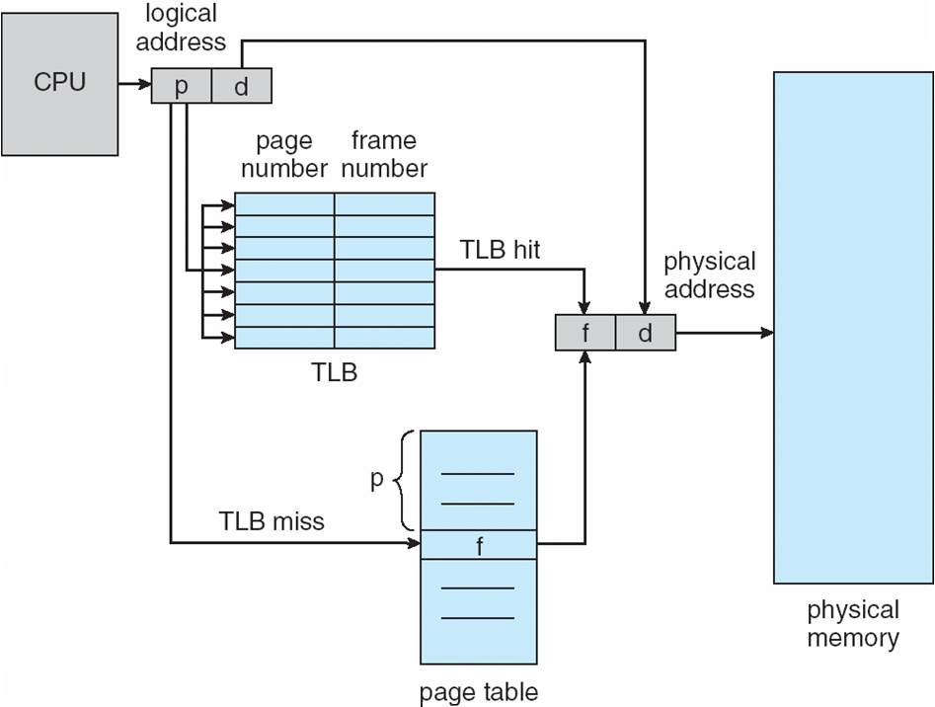
Paging Hardware With TLB

Slide 62
Why Demand paging?
Code needs to be in memory to execute, but entire program rarely used
Error code, unusual routines, large data structures
Entire program code not needed at same time
Consider ability to execute partially-loaded program
Program no longer constrained by limits of physical memory
Each program takes less memory while running -> more programs run at the same time
Increased CPU utilization and throughput with no increase in response time or turnaround time
Less I/O needed to load or swap programs into memory -> each user program runs faster

Slide 63
Why Demand paging?
Virtual address space – logical view of how process is stored in memory
Usually start at address 0, contiguous addresses until end of space
Meanwhile, physical memory organized in page frames
MMU must map logical to physical
Virtual memory can be implemented via:
Demand paging
Demand segmentation

Slide 64
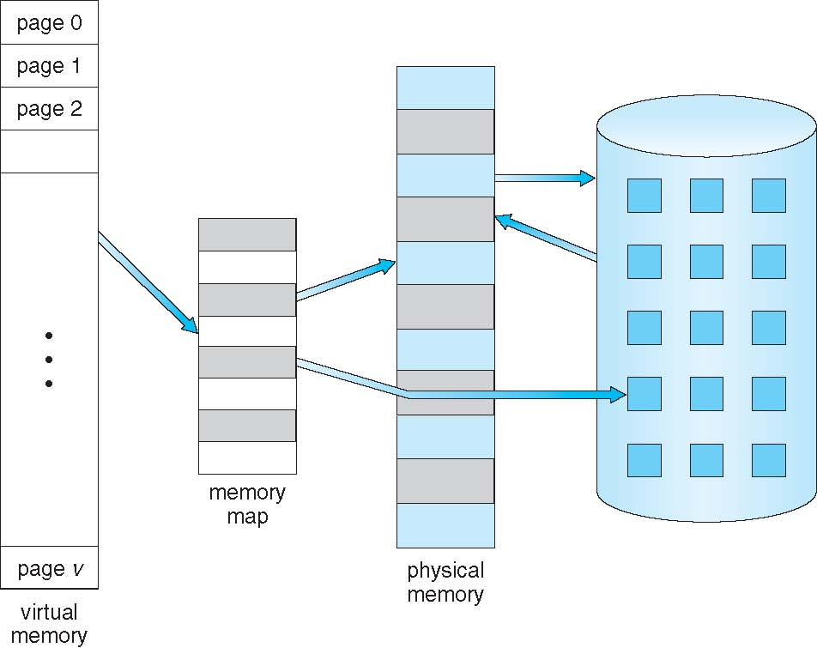
Virtual Memory That is Larger Than Physical Memory

Slide 65
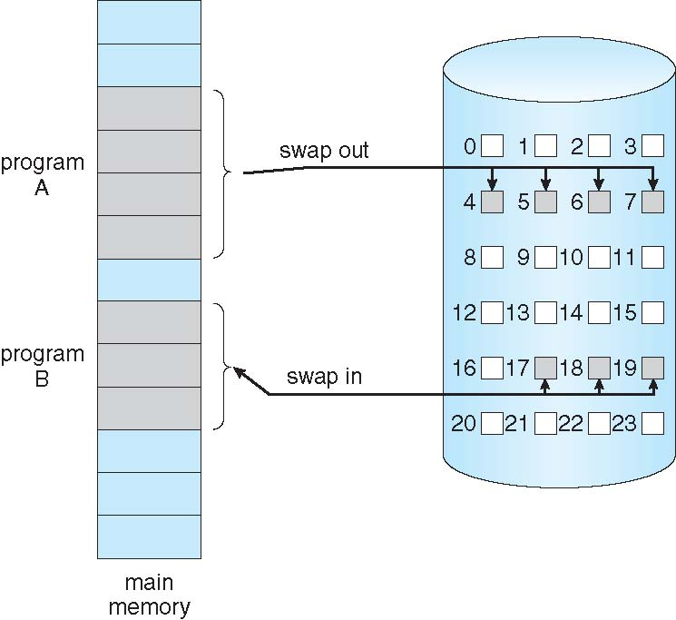
Demand Paging
Could bring entire process into memory at load time
Or bring a page into memory only when it is needed
Less I/O needed, no unnecessary I/O
Less memory needed
Faster response
More users
Similar to paging system with swapping (diagram on right)
Page is needed ⇒ reference to it
invalid reference ⇒ abort
not-in-memory ⇒ bring to memory
Lazy swapper – never swaps a page into memory unless page will be needed
Swapper that deals with pages is a pager

Slide 66
Demand Paging(Cont…)
With swapping, pager guesses which pages will be used before swapping out again
Instead, pager brings in only those pages into memory
How to determine that set of pages?
Need new MMU functionality to implement demand paging
If pages needed are already memory resident
No difference from non demand-paging
If page needed and not memory resident
Need to detect and load the page into memory from storage
Without changing program behavior
Without programmer needing to change code

Slide 67
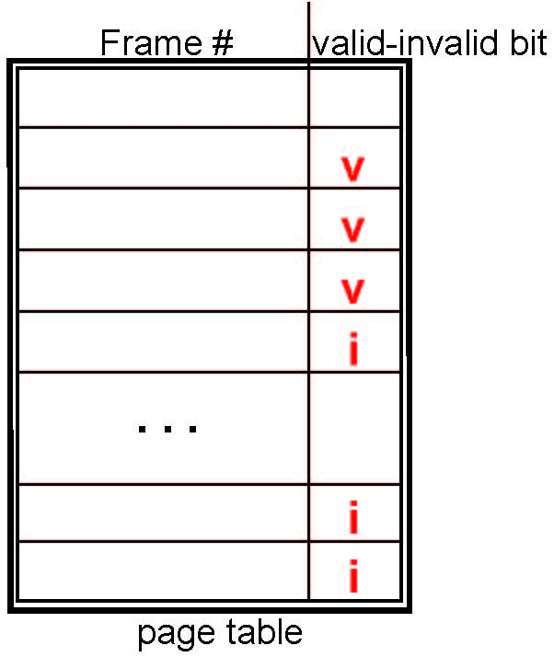
Valid-Invalid Bit
Demand Paging(Cont…)
With each page table entry a valid–invalid bit is associated (v ⇒ in-memory – memory resident, i ⇒ not-in-memory)
Initially valid–invalid bit is set to i on all entries
Example of a page table snapshot:
During MMU address translation, if valid–invalid bit in page table entry is i ⇒ page fault

Slide 68
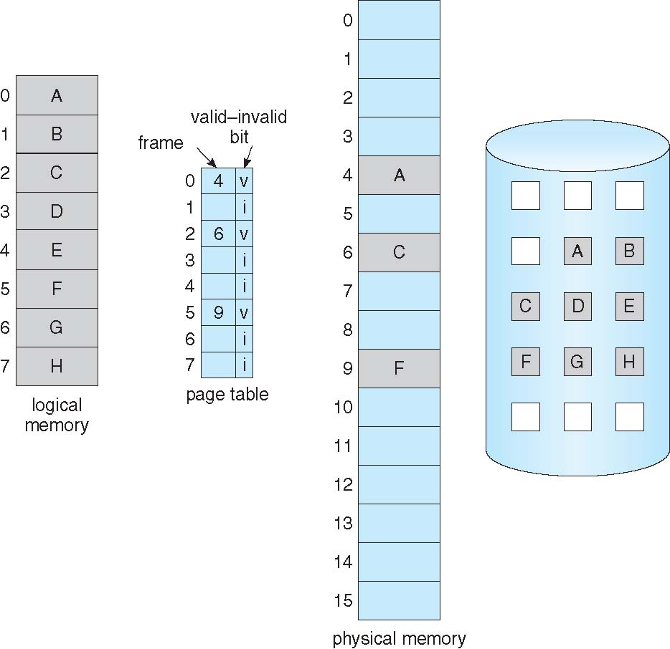
Page Table When Some Pages Are Not in Main Memory
Demand Paging(Cont…)

Slide 69
Page Fault
Demand Paging(Cont…)
If there is a reference to a page, first reference to that page will trap to operating system:
page fault
Operating system looks at another table to decide:
Invalid reference ⇒ abort
Just not in memory
Find free frame
Swap page into frame via scheduled disk operation
Reset tables to indicate page now in memory Set validation bit = v
Restart the instruction that caused the page fault

Slide 70
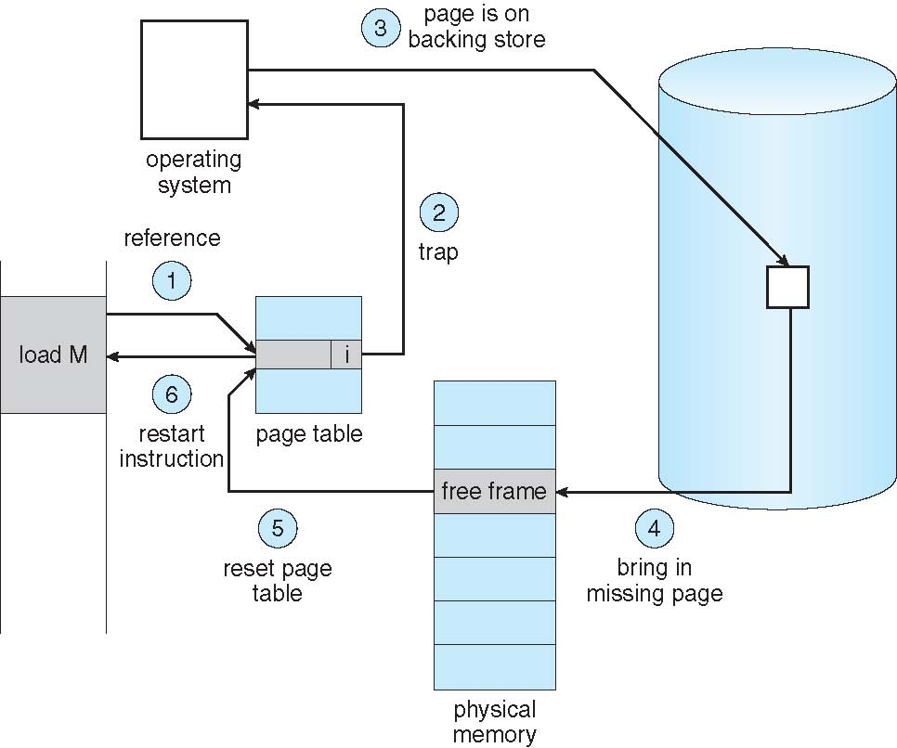
Steps in Handling a Page Fault
Demand Paging(Cont…)

Slide 71
What Happens if There is no Free Frame?
Demand Paging(Cont…)
Used up by process pages
Also in demand from the kernel, I/O buffers, etc
How much to allocate to each?
Page replacement – find some page in memory, but not really in use, page it out
Algorithm – terminate? swap out? replace the page?
Performance – want an algorithm which will result in minimum number of page faults
Same page may be brought into memory several times

Slide 72
Page Replacement
Prevent over-allocation of memory by modifying page-fault service routine to include page replacement
Use modify (dirty) bit to reduce overhead of page transfers – only modified pages are written to disk
Page replacement completes separation between logical memory and physical memory – large virtual memory can be provided on a smaller physical memory

Slide 73
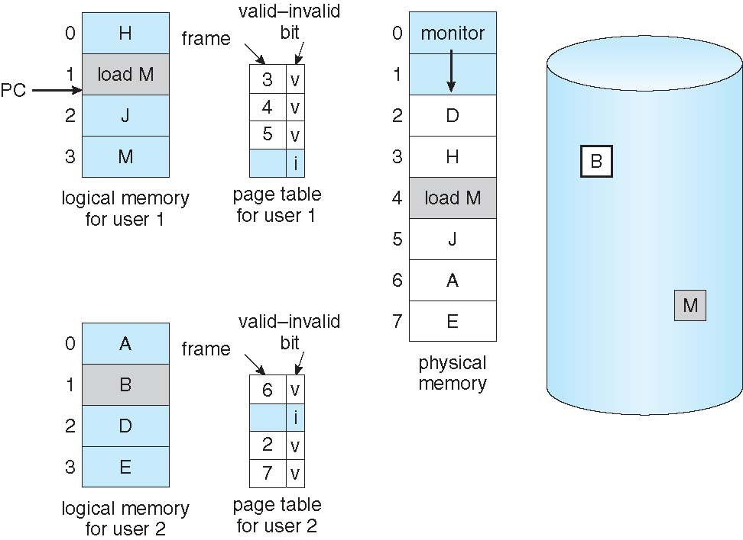
Need For Page Replacement

Slide 74
Basic Page Replacement
Find the location of the desired page on disk
Find a free frame: - If there is a free frame, use it - If there is no free frame, use a page replacement algorithm to select a victim frame - Write victim frame to disk if dirty
Bring the desired page into the (newly) free frame; update the page and frame tables
Continue the process by restarting the instruction that caused the trap
Note now potentially 2 page transfers for page fault – increasing EAT

Slide 75
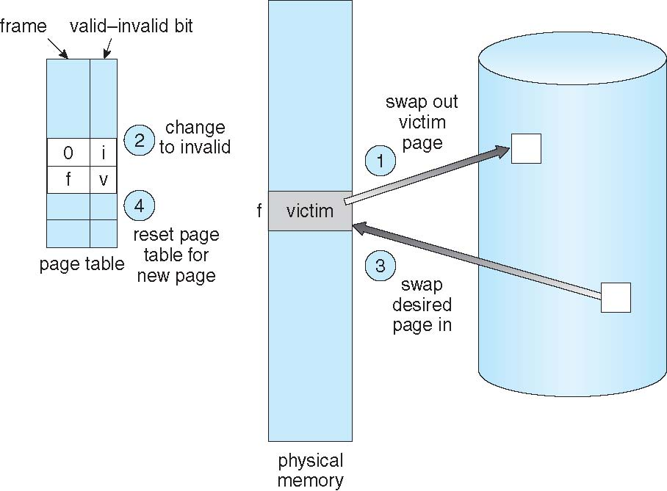
Page Replacement

Slide 76
Page and Frame Replacement Algorithms
Frame-allocation algorithm determines
How many frames to give each process
Which frames to replace
Page-replacement algorithm
Want lowest page-fault rate on both first access and re-access
Evaluate algorithm by running it on a particular string of memory references (reference string) and computing the number of page faults on that string
String is just page numbers, not full addresses
Repeated access to the same page does not cause a page fault
Results depend on number of frames available
In all our examples, the reference string of referenced page numbers is
7,0,1,2,0,3,0,4,2,3,0,3,0,3,2,1,2,0,1,7,0,1

Slide 77
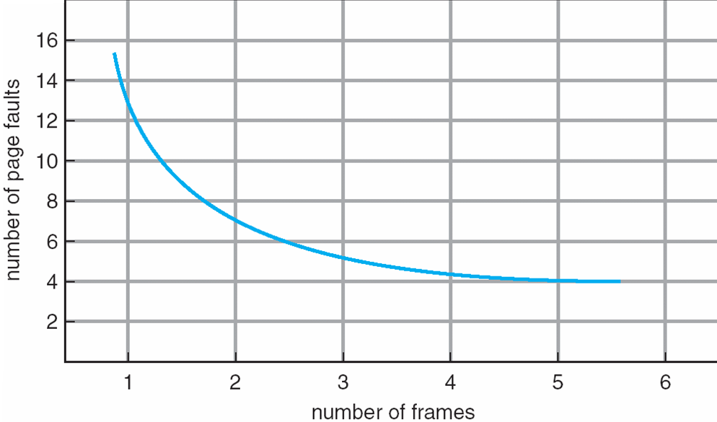
Graph of Page Faults Versus The Number of Frames

Slide 78
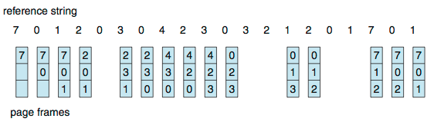
First-In-First-Out (FIFO) Algorithm
Reference string: 7,0,1,2,0,3,0,4,2,3,0,3,0,3,2,1,2,0,1,7,0,1
3 frames (3 pages can be in memory at a time per process)
Can vary by reference string: consider 1,2,3,4,1,2,5,1,2,3,4,5
Adding more frames can cause more page faults!
Belady’s Anomaly
How to track ages of pages?
Just use a FIFO queue
15 page faults

Slide 79
FIFO Illustrating Belady’s Anomaly

Slide 80
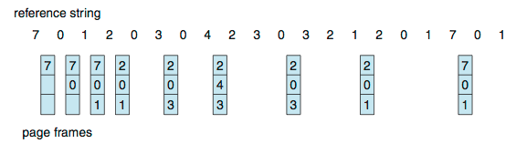
Optimal Algorithm
Replace page that will not be used for longest period of time
See in future which reference page will not be used and select that as victim page
How do you know this?
Can’t read the future
Used for measuring how well your algorithm performs

Slide 81
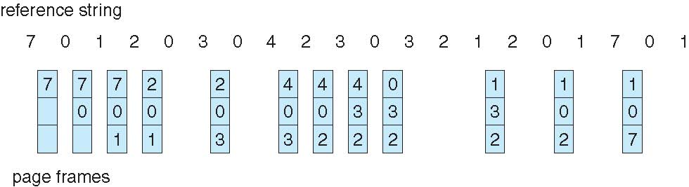
Least Recently Used (LRU) Algorithm
Use past knowledge rather than future
Replace page that has not been used in the most amount of time
Associate time of last use with each page
12 faults – better than FIFO but worse than OPT
Generally good algorithm and frequently used
But how to implement?

Slide 82
LRU Algorithm (Cont.)
Counter implementation
Every page entry has a counter; every time page is referenced through this entry, copy the clock into the counter
When a page needs to be changed, look at the counters to find smallest value
Search through table needed
Stack implementation
Keep a stack of page numbers in a double link form:
Page referenced:
move it to the top
requires 6 pointers to be changed
But each update more expensive
No search for replacement
LRU and OPT are cases of stack algorithms that don’t have Belady’s Anomaly

Slide 83
Use Of A Stack to Record Most Recent Page References

Slide 84
Global vs. Local Replacement
Frames are allocated to various processes
If process P_{i} generates a page fault
select for replacement one of its frames
select for replacement a frame from another process
Local replacement – each process selects from only its own set of allocated frames
More consistent per-process performance
But possibly underutilized memory
Global replacement – process selects a replacement frame from the set of all frames; one process can take a frame from another
But then process execution time can vary greatly
But greater throughput ----- so more common
Processes can not control its own page fault rate
Depends on the paging behavior of other processes

Slide 85
Thrashing
If this page fault and then swapping happening very frequently at higher rate, then operating system has to spend more time to swap these pages. This state is called thrashing. Because of this, CPU utilization is going to be reduced.
If a process does not have “enough” pages, the page-fault rate is very high
Page fault to get page
Replace existing frame
But quickly need replaced frame back
This leads to:
Low CPU utilization
Operating system thinking that it needs to increase the degree of multiprogramming
Another process added to the system
Thrashing ≡ a process is busy swapping pages in and out

Slide 86
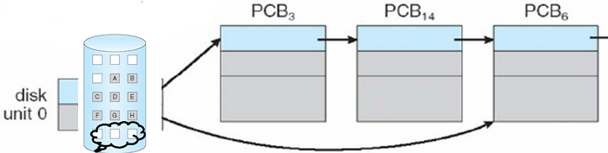
Thrashing
Global page replacement
Process enters new phase (subroutine call) execution
Page fault
Taking frames from other processes
Replace “active” frames of other processes
These processes start page fault
These faulting processes wait on the device queue for disk
Ready queue empty
CPU utilization decreases
CPU scheduler increases the degree of multiprogramming
More page faults
Drop in CPU utilization
Page fault increases tremendously
Disk

Slide 87
Thrashing
The effect of Thrashing is 1.CPU becomes idle. 2.Decreasing the utilization increases the degree of multiprogramming and hence bringing more processes at a time which in fact increases the thrashing exponentially.

Slide 88
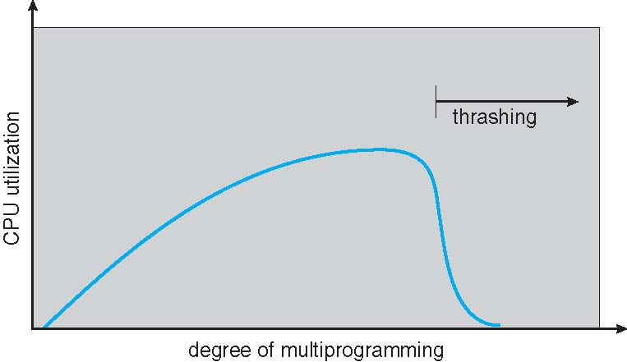
Thrashing (Cont.)

